Slide 1

RDBMS
240110102
Unit 2 - Entity Relationship Modelling (CO2)
Topics:
Components of an E-R Model: Entity, Entity Sets, Attributes and keys – Super Key, Primary Key, Candidate Key, Alternate Key, Relationship Types, Composite entities, Weak entity
Relational Database design by ER to Relational Mapping
Examples for ER Diagram: College Management System, Railway Reservation System, Hospital Management System, Library Management System, e-Business Management System (can take any eBusiness example like online shopping, online food ordering etc.…)
09/11/2025

Slide 2
Entities and Attributes
Entity:
A thing or an object.
It has set of properties
Values for some set of properties, it can uniquely identify it
Entities are specific objects or things in the mini-world that are represented in the database.
For example the EMPLOYEE John Smith, the Research DEPARTMENT, the ProductX PROJECT
Attributes are properties used to describe an entity.
For example an EMPLOYEE entity may have the attributes Name, SSN, Address, Sex, BirthDate
A specific entity will have a value for each of its attributes.
For example a specific employee entity may have Name='John Smith', SSN='123456789', Address ='731, Fondren, Houston, TX', Sex='M', BirthDate='09-JAN-55‘
Each attribute has a value set (or data type) associated with it – e.g. integer, string, subrange, enumerated type, …

Slide 3
Type of Attributes
Simple Attribute
Each entity has a single atomic value for the attribute.
For example: SSN or Gender.
Composite Attribute
An attribute where the values of that attribute can be further subdivided into meaningful sub-parts."
For Example: Emp_Name – may be stored as first name, last name, middle initial
Address(Apt#, House#, Street, City, State, ZipCode, Country)
Multivalue Attribute
An attribute that can have more than one value associated with the key of the entity.
For Example: Degree of a person, Hobby of a person, Bank branch Location, Color of a car etc.
Derived Attribute
An attribute whose value is calculated (derived) from other attributes.
The derived attribute need not be physically stored within the database; instead, it can be derived by using an algorithm.
For Example: Age field (can be derived from Birth_date field)
Key Attribute
Uniquely identifies each entity in an entity set.
Example: Roll_No for Student, Emp_ID for Employee.

Slide 4
Composite and Multi-Valued Attributes (Nested Attributes)
In general, composite and multi-valued attributes can be nested arbitrarily to any number of levels, though this is rare in practice.
A composite attribute is one that can be divided into smaller sub-parts.
A multi-valued attribute can hold multiple values for a single entity.
When both properties exist together, the attribute is called a composite multi-valued attribute.
Example: student entity, PreviousDegrees attribute
PreviousDegrees is multi-valued because a student can have more than one previous degree.
Each PreviousDegree has sub-parts, so it is composite: {PreviousDegrees (College, Year, Degree, Field)}

Slide 5
Entity Type and Entity Sets
A database usually contains groups of entities that are similar
For Ex. Company Employees
Each entity shares the same attribute but each entity has its own values for each attribute
Entity Type: A collection of entities that have the same attributes
Entity Set: The collection (or group) of all entities of a particular entity type stored in the database.
Entity set is usually referred by using the same name as the entity type.
For Ex.: EMPLOYEE refers to both type of entity as well as the collection of all employee entities in the Database.

Slide 6
Relationship
A relationship relates two or more distinct entities with a specific meaning.
Eg. Employee WORKS FOR Department -------”Work For” is the relationship
Student ENROLLS Course -----------”Enrolls” is the relationship
A relationship type R among n entity types E1, E2, ..., En defines a set of associations—or a relationship set—among entities from these entity types.
As for the case of entity types and entity sets, a relationship type and its corresponding relationship set are customarily referred to by the same name, R.

Slide 7
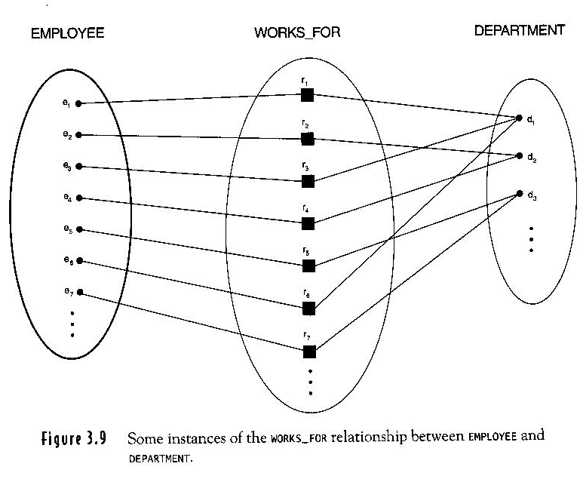
Relationship instances
In the mini-world represented by figure below employees e1, e3 and e6 work for department d1, e2 and e4 works for d2 and e5 and e7 work for d3.

Slide 8
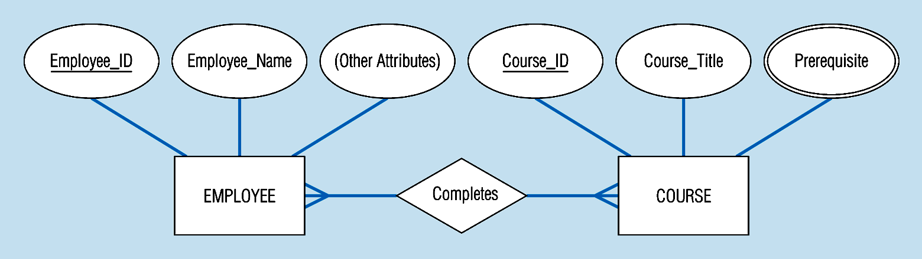
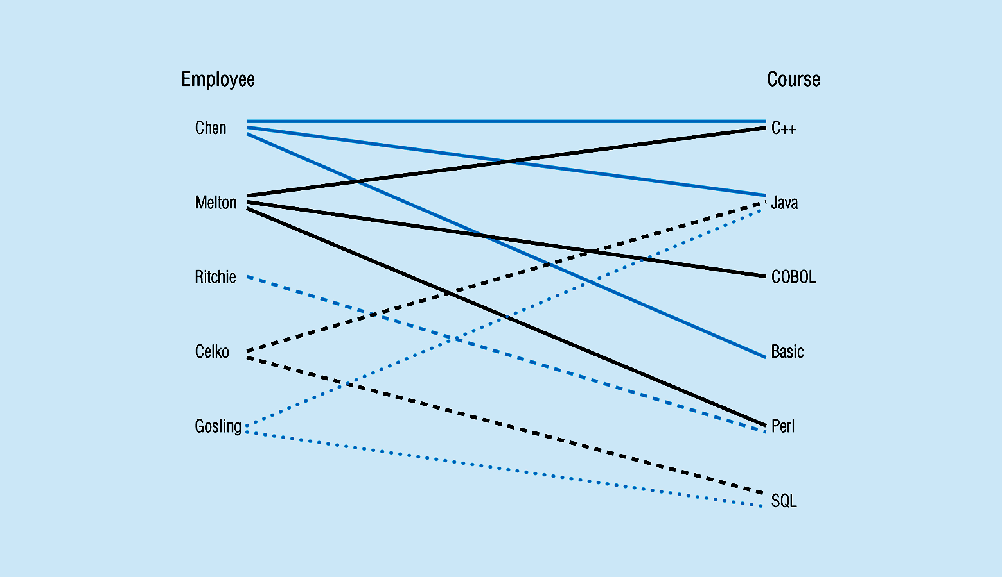
Relationship types and instances
Notes:
17

Slide 9
Relationship type vs. relationship set
Previous figures displayed the relationship sets
Each instance in the set relates individual participating entities – one from each participating entity type
In ER diagrams, we represent the relationship type as follows:
Diamond-shaped box is used to display a relationship type
Connected to the participating entity types via straight lines

Slide 10
Relationship type vs. relationship set
Relationship Type:
Defines the association (link) between two or more entity types.
Is the schema description of a relationship
Identifies the relationship name and the participating entity types
Also identifies certain relationship constraints
Relationship Set:
A collection of all relationships (instances) of a particular relationship type in the database.
It contains actual data showing which entities are related.
The current set of relationship instances represented in the database
The current state of a relationship type

Slide 11
Cardinality and Participation Constraints
In general, cardinality tells you "How many".
Cardinality can be:
One to one (1:1): every time one entity occurs, there is exactly one occurrence of another entity.
One to many (1:m): every time one entity occurs, there are multiple occurrences of another entity.
Many to many (m:m): for each occurrence of an entity, there can be one or many occurrences of another—an vice versa.
Participation Constraints:
Total Participation
Partial Participation

Slide 12
Example for 1:1 Relationship Type
In an Entity-Relationship (ER) Model, a 1:1 (one-to-one) relationship means:
One instance of Entity A is associated with only one instance of Entity B, and vice versa.
🔹 Example 1: Person – Passport
Person → Each person has one passport.
Passport → Each passport belongs to one person only.
🔹 Example 2: Husband – Wife
Husband → one wife only.
Wife → one husband only.
📌 Key Point: In ER diagrams, the 1:1 relationship is shown by connecting two entities with a line and placing 1 on both ends.

Slide 13
Example for 1:M Relationship Type
In an Entity-Relationship (ER) Model, a 1:M (one-to-many) relationship means:
One instance of Entity A can be associated with many instances of Entity B.
But each instance of Entity B is related to only one instance of Entity A.
🔹 Example 1: Teacher – Students
Teacher → One teacher can teach many students.
Student → Each student is taught by one teacher (in this relationship).
🔹 Example 2: Department – Employees
Department → One department can have many employees.
Employee → Each employee belongs to only one department.
🔹 Example 3: Mother – Children
Mother → One mother can have many children.
Child → Each child has one biological mother
📌 Key point: "1" is placed on the side where only one instance exists, and "M" (many) is placed on the side where multiple instances exist.

Slide 14
Example for N:M Relationship Type
In an Entity-Relationship (ER) Model, a many-to-many (M:N) relationship means:
One instance of Entity A can be associated with many instances of Entity B,
and one instance of Entity B can also be associated with many instances of Entity A.
🔹 Example 1: Students – Courses
Student → One student can enroll in many courses.
Course → One course can have many students enrolled.
🔹 Example 2: Authors – Books
Author → One author can write many books.
Book → One book can be written by many authors
🔹 Example 3: Doctors – Patients
Doctor → A doctor can treat many patients.
Patient → A patient can be treated by many doctors.
📌 Key point: In practice, an M:N relationship is usually broken into two 1:M relationships using a bridge/associative entity (like Enrollment between Student & Course).

Slide 15
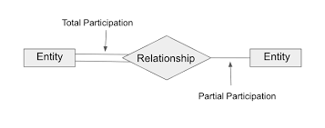
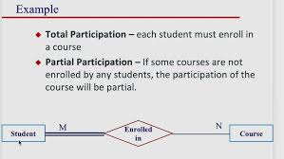
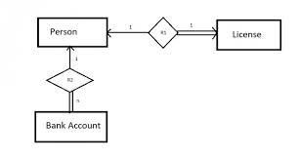
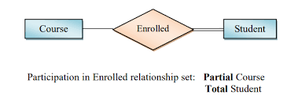
Participation Constraint

Slide 16
Degree of a Relationship
Based on the number of linked entity types, we have 4 types of degrees of relationships.
Unary
Binary
Ternary
N-ary

Slide 17
Unary Relationship
In this type of relationship, both the associating entity type are the same. So, we can say that unary relationships exist when both entity types are the same and we call them the degree of relationship is 1. Or in other words, in a relation only one entity set is participating then such type of relationship is known as a unary relationship.
Example: In a particular class, we have many students, there are monitors too. So, here class monitors are also students. Thus, we can say that only students are participating here. So the degree of such type of relationship is 1.

Slide 18
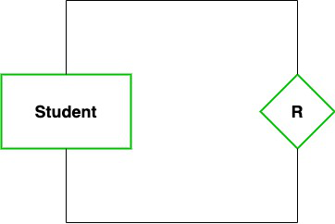
Example – Unary Relationship

Slide 19
Binary Relationship
In a Binary relationship, there are two types of entity associates.
Binary relationship exists when there are two types of entity and we call them a degree of relationship is 2.
Or in other words, in a relation when two entity sets are participating then such type of relationship is known as a binary relationship. This is the most used relationship and one can easily be converted into a relational table.

Slide 20
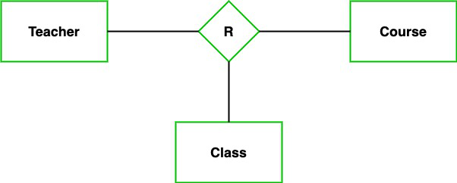
Ternary Relationship
In the Ternary relationship, there are three types of entity associates.
Ternary relationship exists when there are three types of entity and we call them a degree of relationship is 3

Slide 21
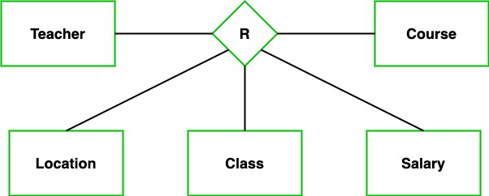
N-ary Relationship
In the N-ary relationship, there are n types of entity that associates.
N-ary relationship exists when there are n types of entities.

Slide 22
Company Management System
Organization has multiple departments
Employees work for the department and manages the department
Per department there is an supervisor (an employee)
Department executes different projects
Employees work on those projects on hourly basis
Organization manages the information of the Employee’s dependents also.

Slide 23
Weak Entity Types
An entity that does not have a key attribute
A weak entity must participate in an identifying relationship type with an owner or identifying entity type
Entities are identified by the combination of:
A partial key of the weak entity type
The particular entity they are related to in the identifying entity type
Example: 1
A DEPENDENT entity is identified by the dependent’s first name, and the specific EMPLOYEE with whom the dependent is related
Name of DEPENDENT is the partial key
DEPENDENT is a weak entity type
EMPLOYEE is its identifying entity type via the identifying relationship type DEPENDENT_OF
Example: 2
ORDER (Strong Entity) and ORDERITEM (Weak Entity).
An OrderItem cannot exist without an Order.
Partial key: ItemNumber within an order.
Weak relationship: "Contains" between Order and OrderItem.

Slide 24
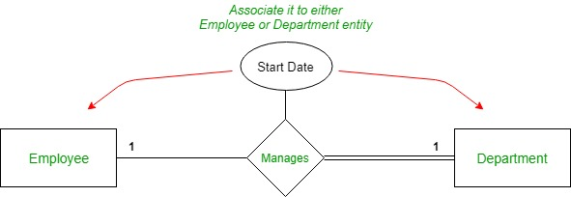
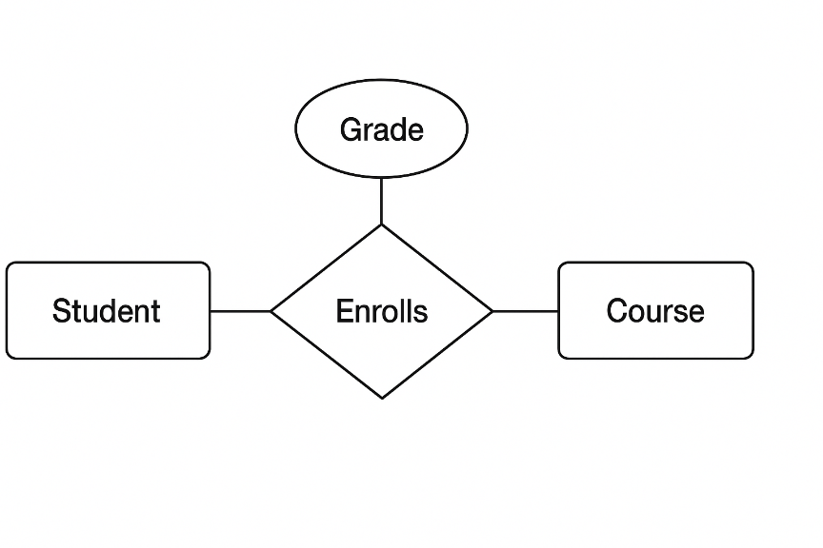
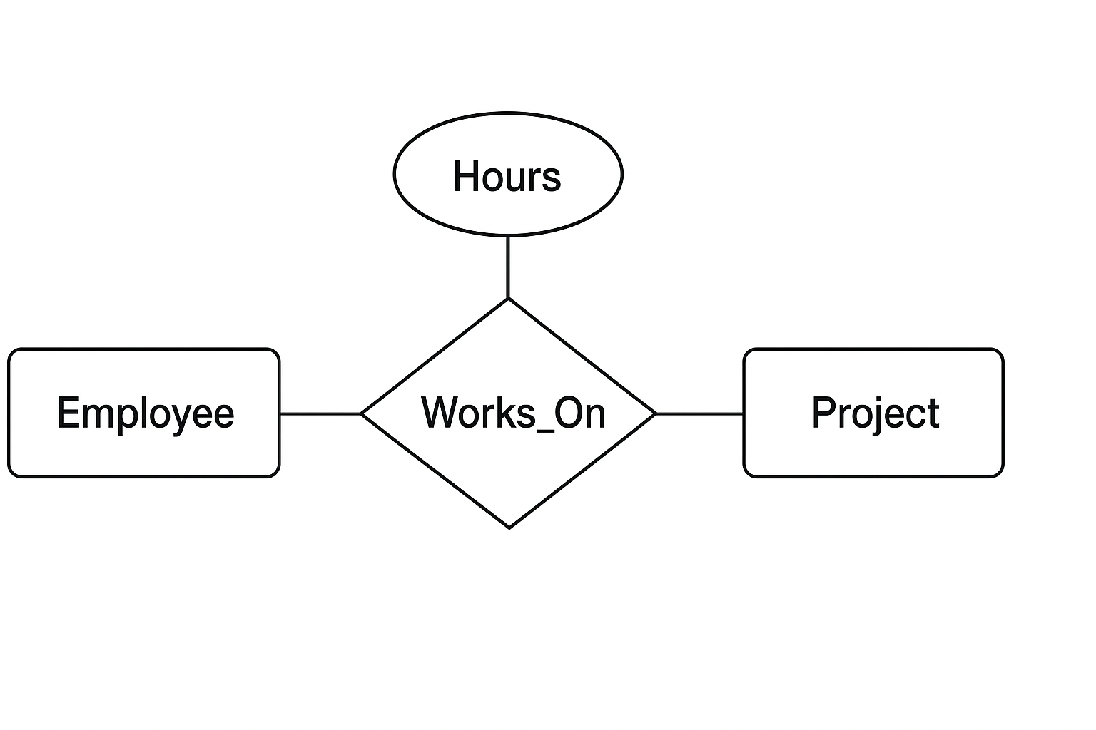
Relationship Type Attribute
Relationship attribute is a specific characteristic or property of that relationship itself, providing more detail about how the entities are connected
Doctor -------- Treats(Date_of_Treatment) -------- Patient
Employee -------- Works_On(Hours) -------- Project

Slide 25
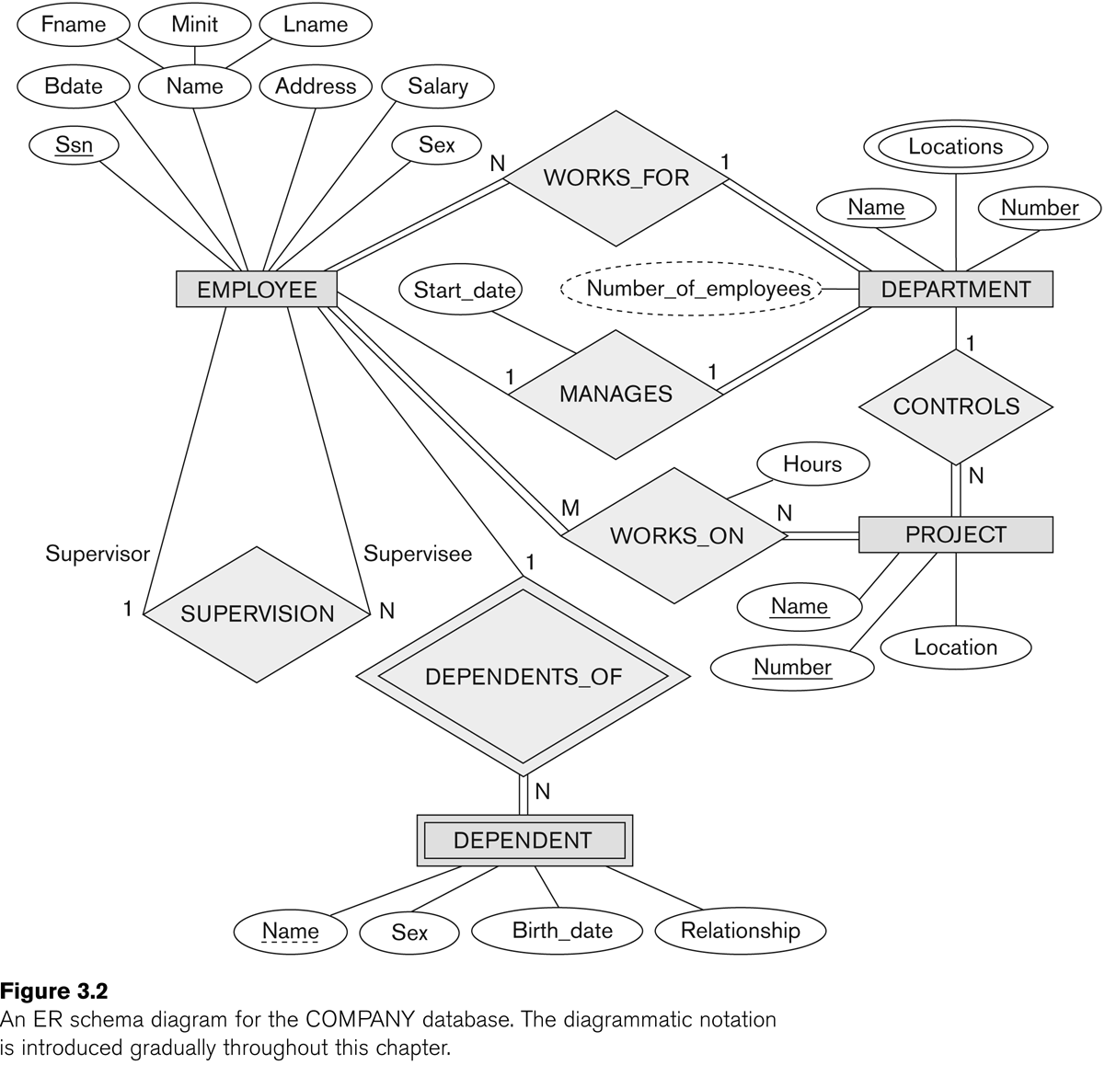
Example

Slide 26
University Management System
Different College / institute are there under the university
Each College has different departments that manages information related to courses
Students are enrolled in a course
Courses offers different subjects
Faculties teaches subjects in different courses
One faculty in each department is the head of that department
One faculty is the director of the college / institute.
Course has exam, students appear for the exam and get grades for the same

Slide 27
Draw an ER Diagram for the Library Management System.
In a Library different types of books are purchased for the students to refer.
Books are categorized by different authors and publishers.
Student registers in the library and can issue books.
Librarian manages student details.

Slide 28
Project Management System of an IT Company
A company handles different projects from clients
Manages client information
Project contains different task and duration
Employee has to maintain the daywise timesheet for the task completed

Slide 29
Pharmacy Store Management
Store has many branches, pharmacist as an employee in it
Drug manufacturing company supplies drugs at different branches
Patient come with a doctor’s prescription
Pharmacist sell drugs
The store manages information relate to the doctor, the patient as a customer, the manufacturer and the pharmacist as an employee – branch wise

Slide 30
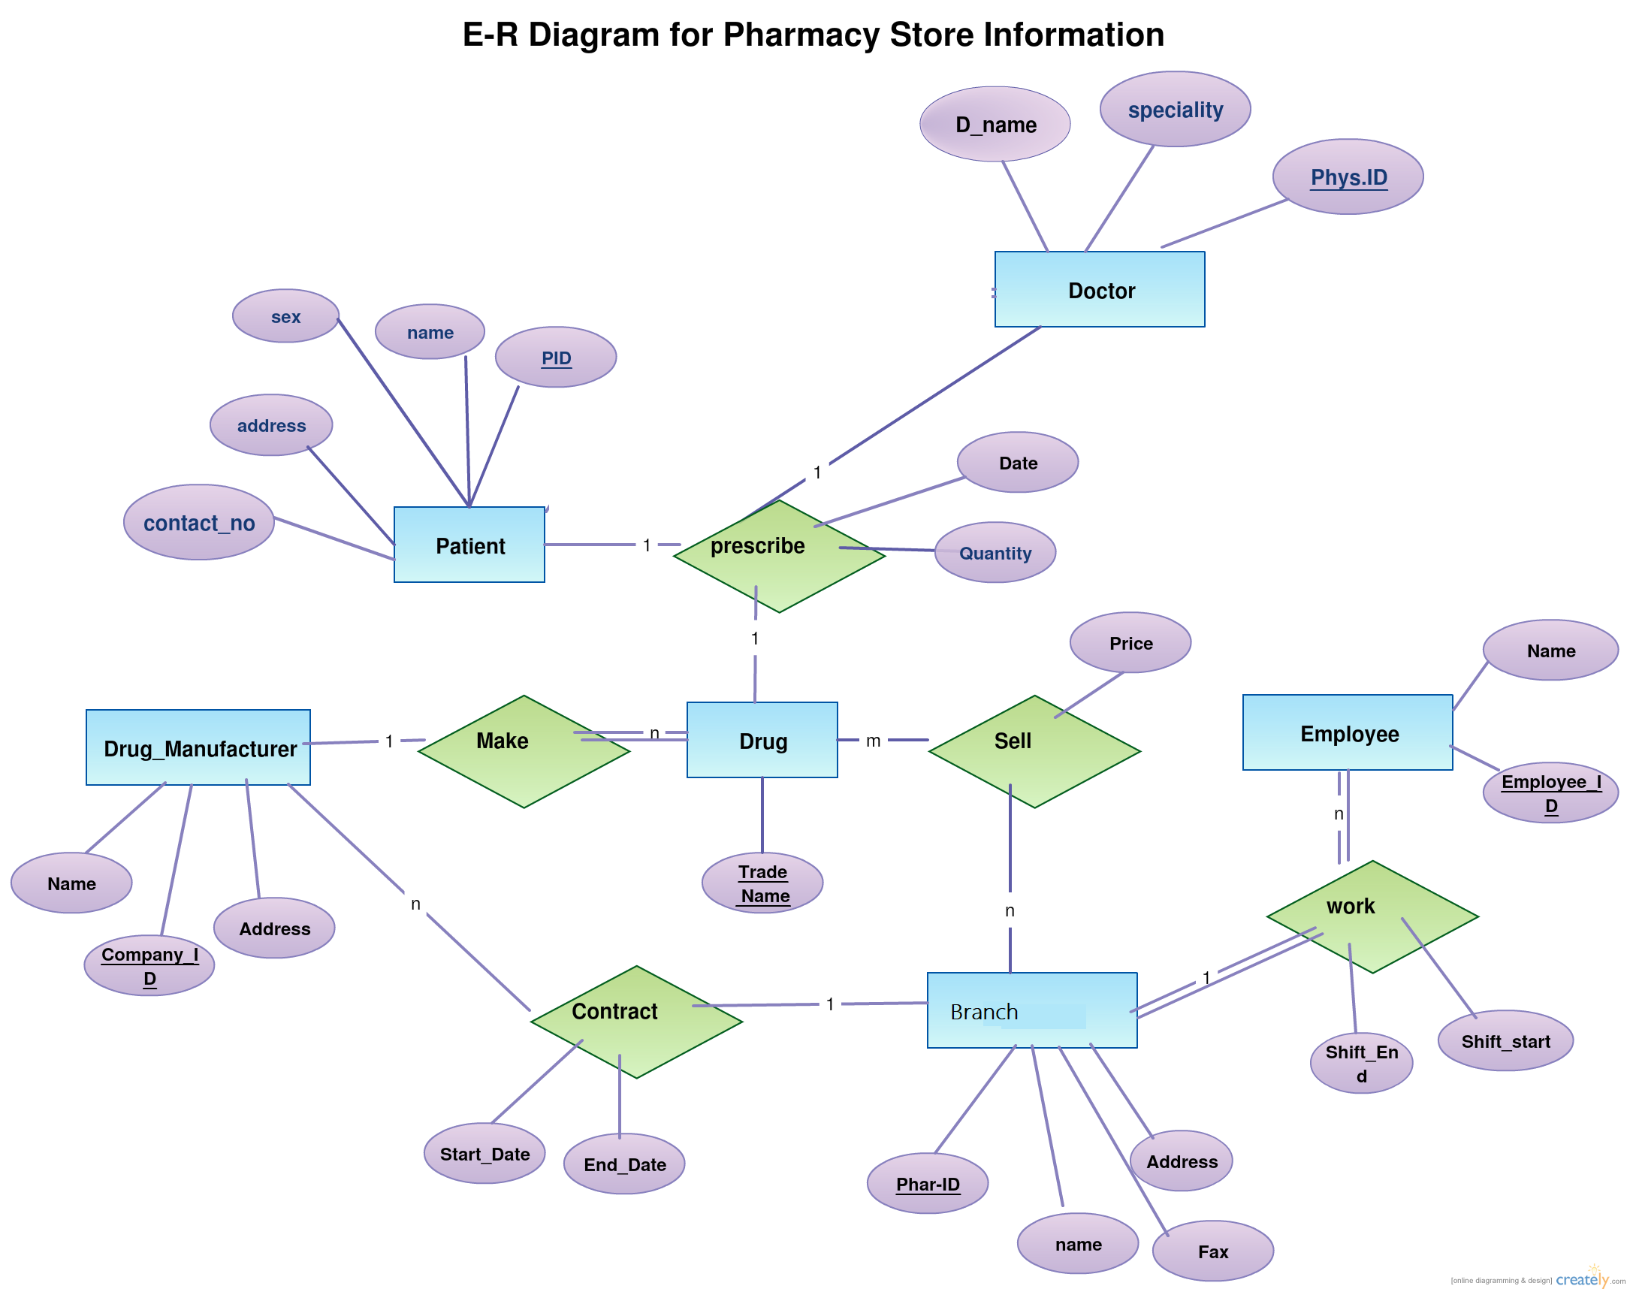

Slide 31
ER Model to Relational Model
ER diagrams mainly comprise of − Entity and its attributes Relationship, which is association among entities.
STEP 1:
Mapping Entity Process Algorithm
Create table for each entity.
Entity's attributes should become fields of tables with their respective data types.
Declare primary key.
Example: We create the relations EMPLOYEE, DEPARTMENT, and PROJECT in the relational schema corresponding to the regular entities in the ER diagram.
SSN, DNUMBER, and PNUMBER are the primary keys for the relations EMPLOYEE, DEPARTMENT, and PROJECT as shown.

Slide 32
ER Model to Relational Model
STEP 2:
Mapping Relationship Process Algorithm
Create table for a relationship if it is a n:m (many to many)relationship.
Add the primary keys of all participating Entities as fields of table with their respective data types.
If relationship has any attribute, add each attribute as field of table.
Declare a primary key composing all the primary keys of participating entities.
Declare all foreign key constraints.
Example: The M:N relationship type WORKS_ON from the ER diagram is mapped by creating a relation WORKS_ON in the relational database schema.
The primary keys of the PROJECT and EMPLOYEE relations are included as foreign keys in WORKS_ON and renamed PNO and ESSN, respectively.
Attribute HOURS in WORKS_ON represents the HOURS attribute of the relation type. The primary key of the WORKS_ON relation is the combination of the foreign key attributes {ESSN, PNO}.

Slide 33
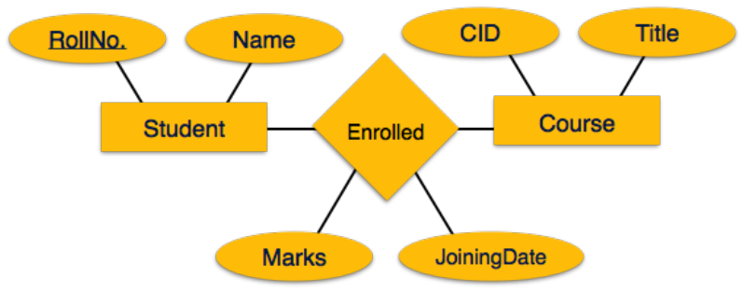
Create a table for Enrolled with fields: (Roll_No, CID, Marks, JoiningDate)

Slide 34
Mapping Relationship type
Mapping of Binary 1:1 Relation Types
For each binary 1:1 relationship type R in the ER schema, identify the relations S and T that correspond to the entity types participating in R.
There are three possible approaches:
Foreign Key approach: Choose one of the relations-say S-and include a foreign key in S the primary key of T. It is better to choose an entity type with total participation in R in the role of S.
Example: 1:1 relation MANAGES is mapped by choosing the participating entity type DEPARTMENT to serve in the role of S, because its participation in the MANAGES relationship type is total.
Merged relation option: An alternate mapping of a 1:1 relationship type is possible by merging the two entity types and the relationship into a single relation. This may be appropriate when both participations are total.
Cross-reference or relationship relation option: The third alternative is to set up a third relation R for the purpose of cross-referencing the primary keys of the two relations S and T representing the entity types.

Slide 35
Mapping Relationship type
Mapping of 1 : N Relationship
For each regular binary 1:N relationship type R, identify the relation S that represent the participating entity type at the N-side of the relationship type.
Include as foreign key in S the primary key of the relation T that represents the other entity type participating in R.
Include any simple attributes of the 1:N relation type as attributes of S.
Example: 1:N relationship types WORKS_FOR, CONTROLS, and SUPERVISION in the figure.
For WORKS_FOR we include the primary key DNUMBER of the DEPARTMENT relation as foreign key in the EMPLOYEE relation and call it DNO.

Slide 36
Mapping Relationship type
Mapping of N-ary Relationship.
For each n-ary relationship type R, where n>2, create a new relationship S to represent R.
Include as foreign key attributes in S the primary keys of the relations that represent the participating entity types.
Also include any simple attributes of the n-ary relationship type (or simple components of composite attributes) as attributes of S.
Example: The relationship type SUPPY in the ER on the next slide.
This can be mapped to the relation SUPPLY shown in the relational schema, whose primary key is the combination of the three foreign keys {SNAME, PARTNO, PROJNAME}

Slide 37
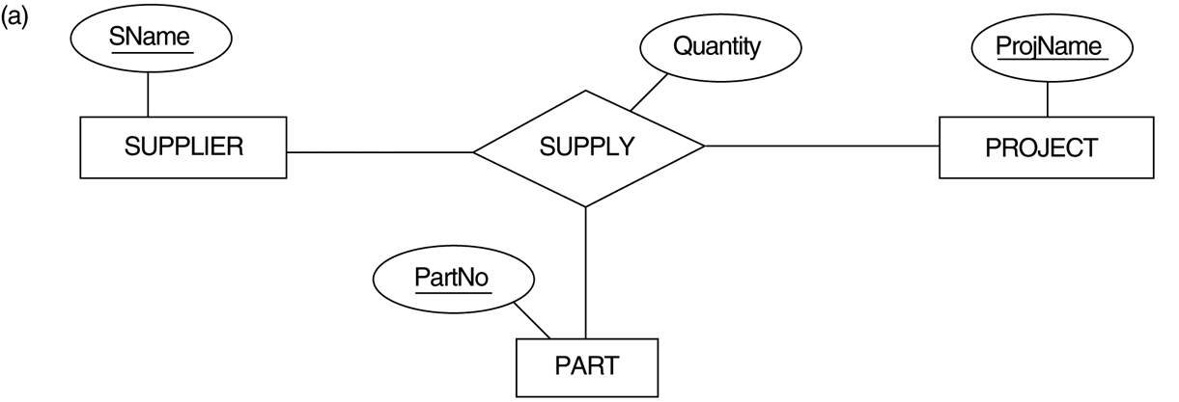
FIGURE 4.11 Ternary relationship types. (a) The SUPPLY relationship.

Slide 38
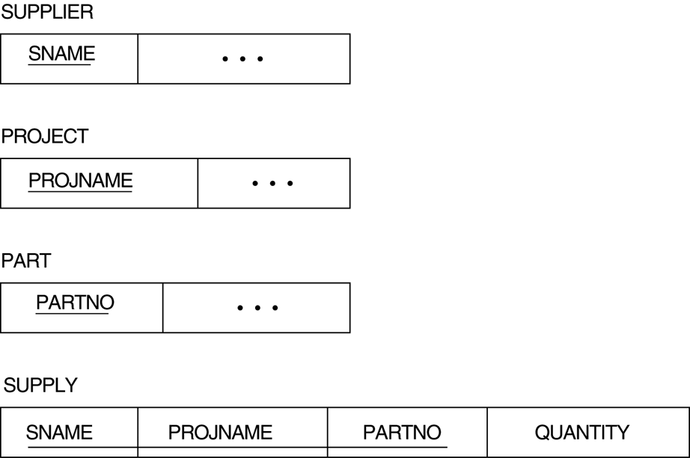
FIGURE 7.3 Mapping the n-ary relationship type SUPPLY from Figure 4.11a.

Slide 39
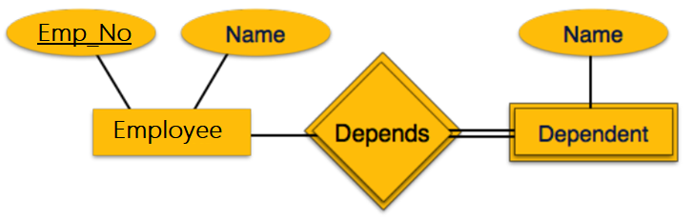
ER Model to Relational Model (Cont…)
STEP 3:
Mapping Weak Entity Sets Process Algorithm
Create table for weak entity set.
Add all its attributes to table as field.
Add the primary key of identifying entity set.
Declare all foreign key constraints.

Slide 40
ER-to-Relational Mapping Algorithm (contd.)
Step 4: Mapping of Multivalued attributes.
For each multivalued attribute A, create a new relation R.
This relation R will include an attribute corresponding to A, plus the primary key attribute K-as a foreign key in R-of the relation that represents the entity type of relationship type that has A as an attribute.
The primary key of R is the combination of A and K. If the multivalued attribute is composite, we include its simple components.
Example: The relation DEPT_LOCATIONS is created.
The attribute DLOCATION represents the multivalued attribute LOCATIONS of DEPARTMENT, while DNUMBER-as foreign key-represents the primary key of the DEPARTMENT relation.
The primary key of R is the combination of {DNUMBER, DLOCATION}.

Slide 41
Example

Slide 42
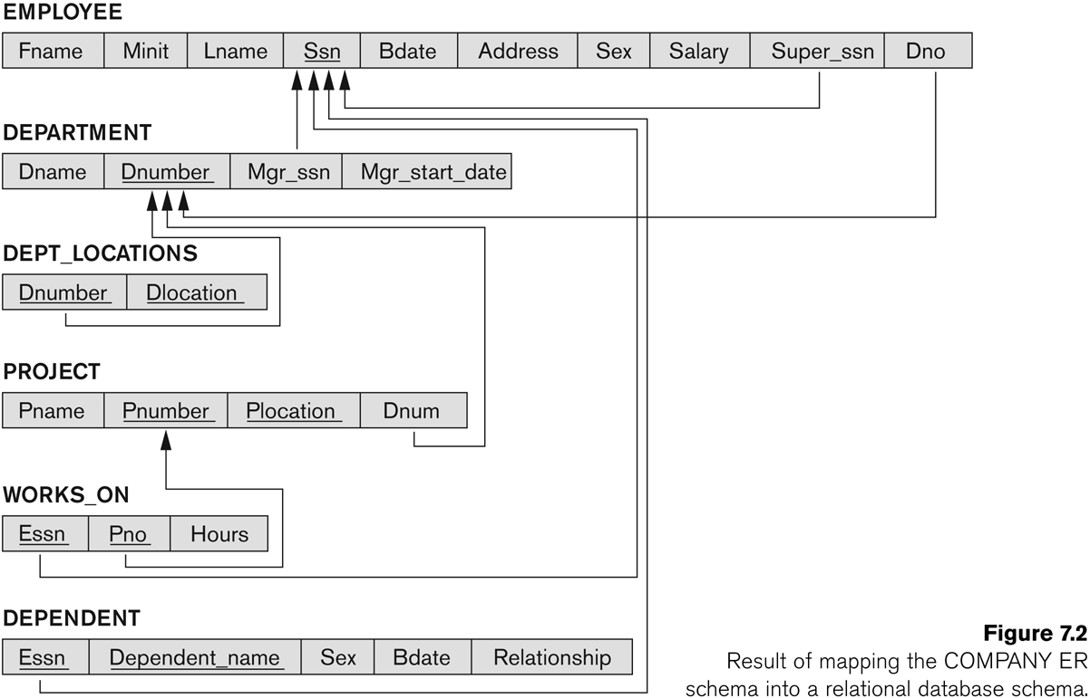
FIGURE 7.2 Result of mapping the COMPANY ER schema into a relational schema.

Slide 43
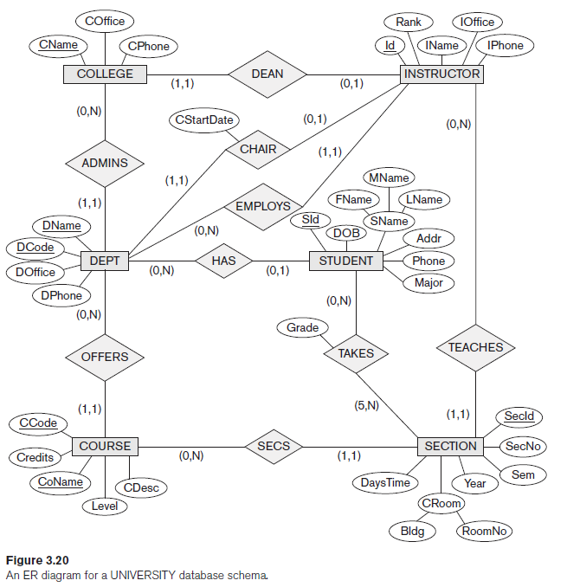
Example

Slide 44
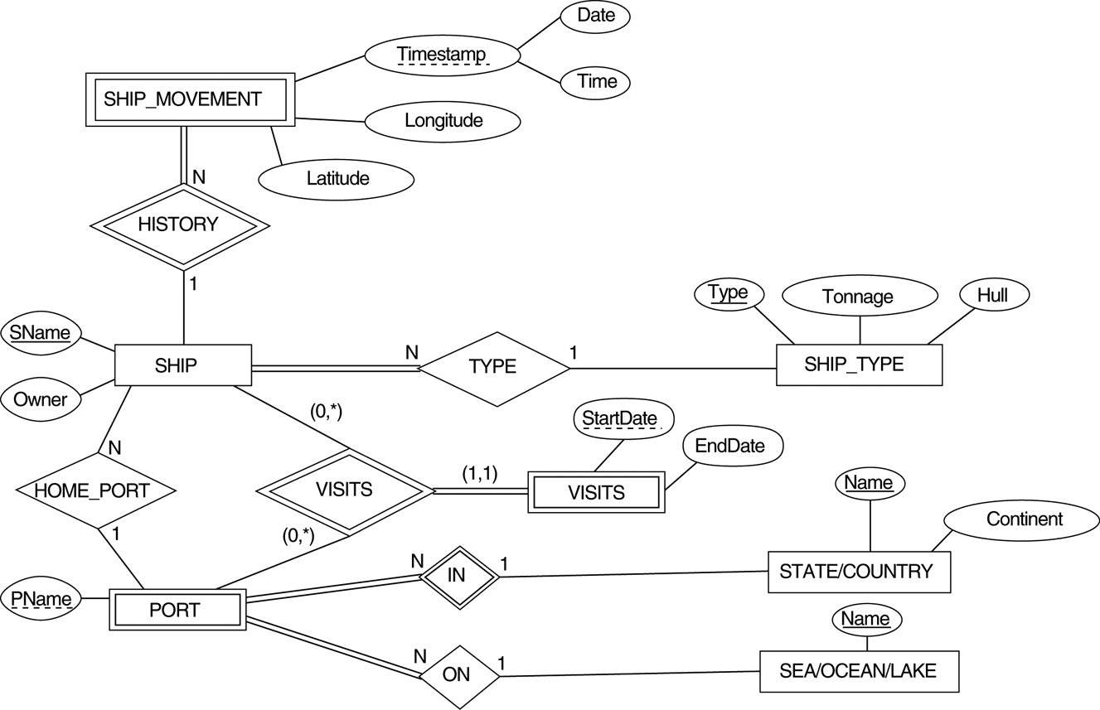
Mapping Exercise
Exercise 7.4.
FIGURE 7.7 An ER schema for a SHIP_TRACKING database.

Slide 45
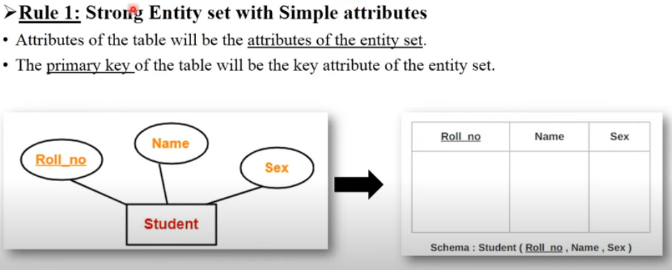
Mapping ER to Table

Slide 46
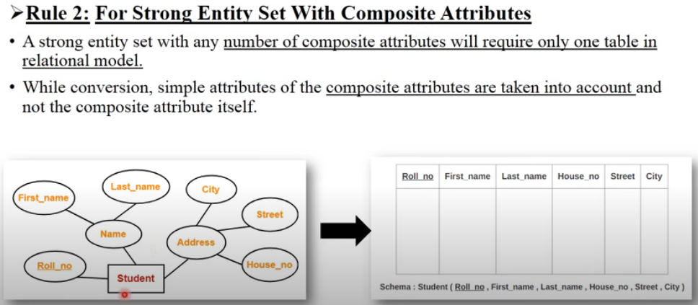

Slide 47
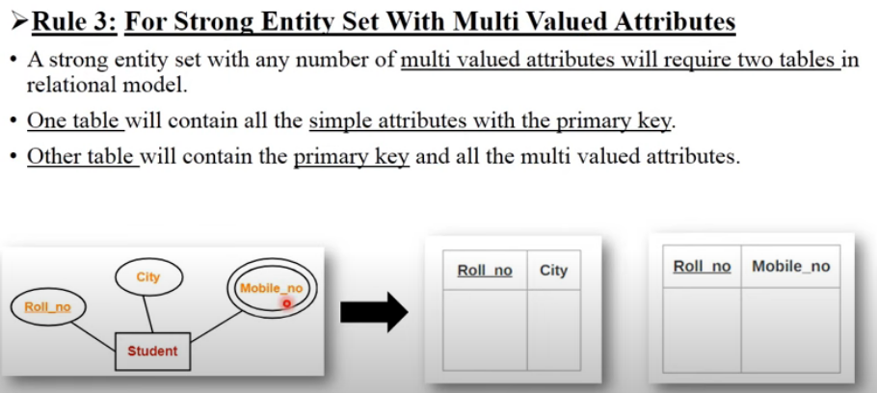

Slide 48
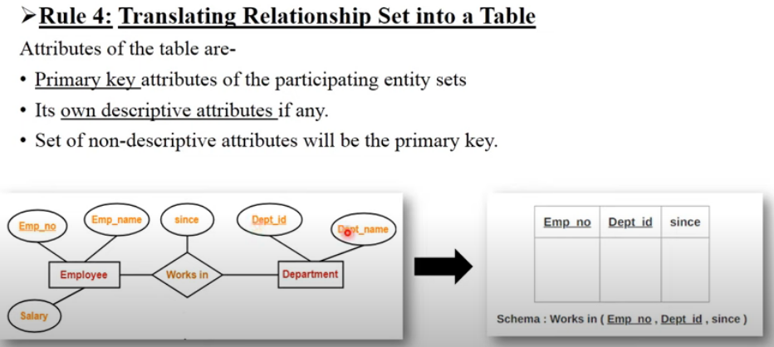

Slide 49
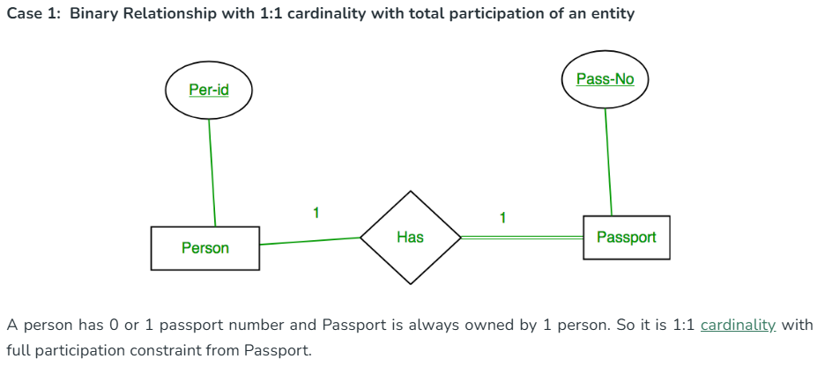

Slide 50
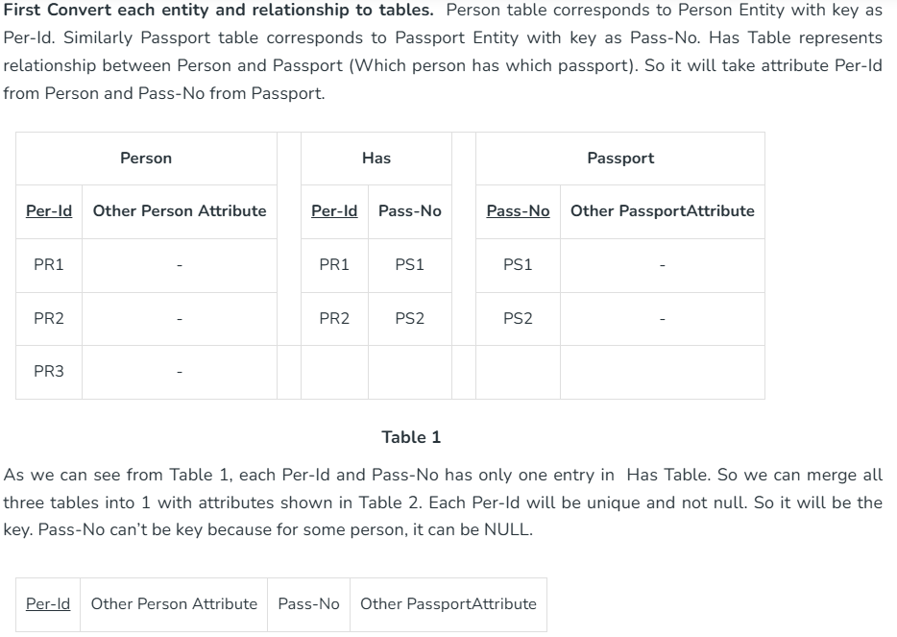

Slide 51
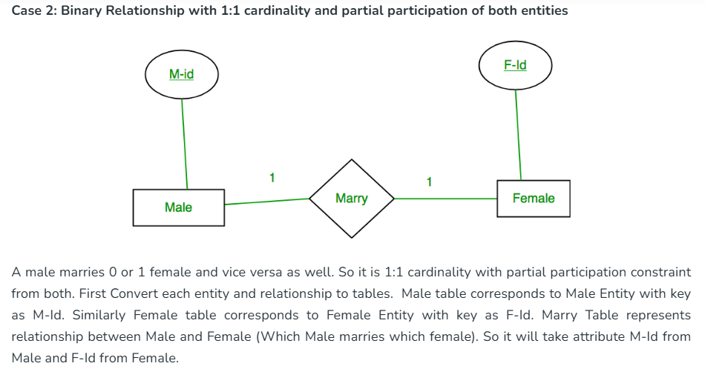

Slide 52
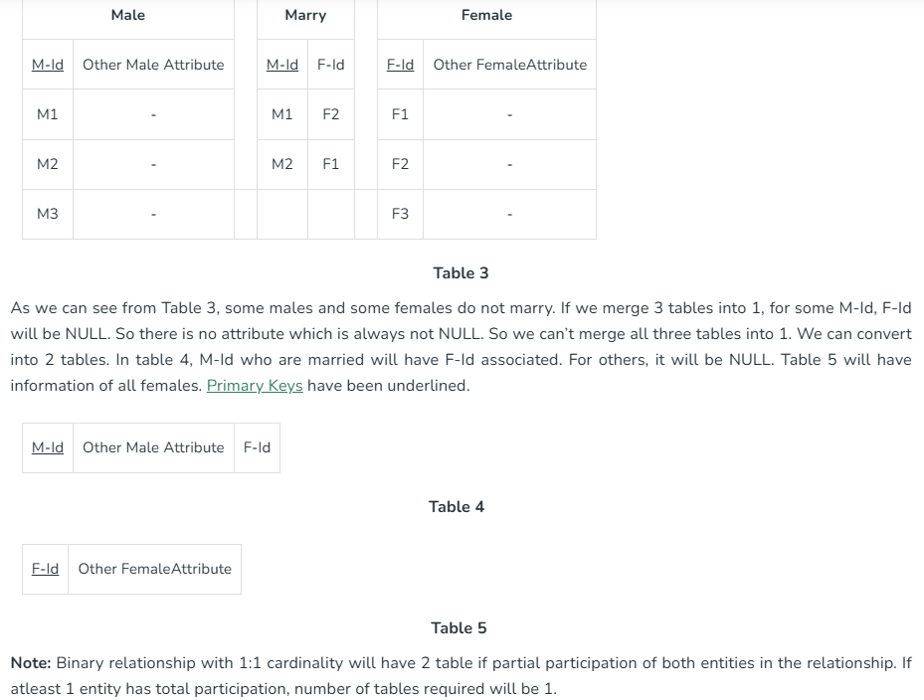

Slide 53
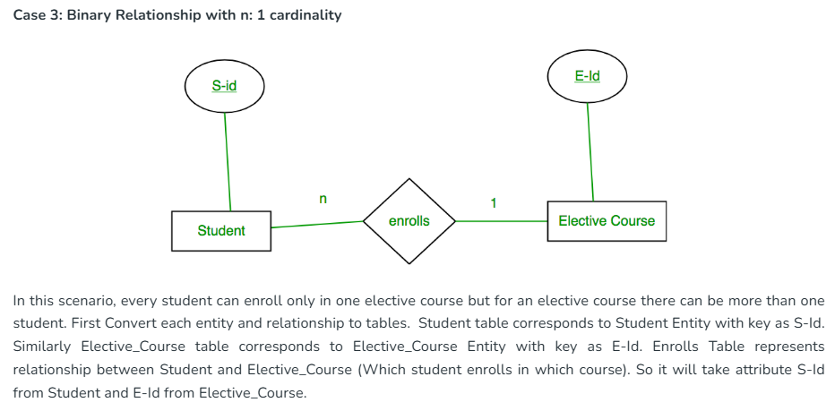

Slide 54
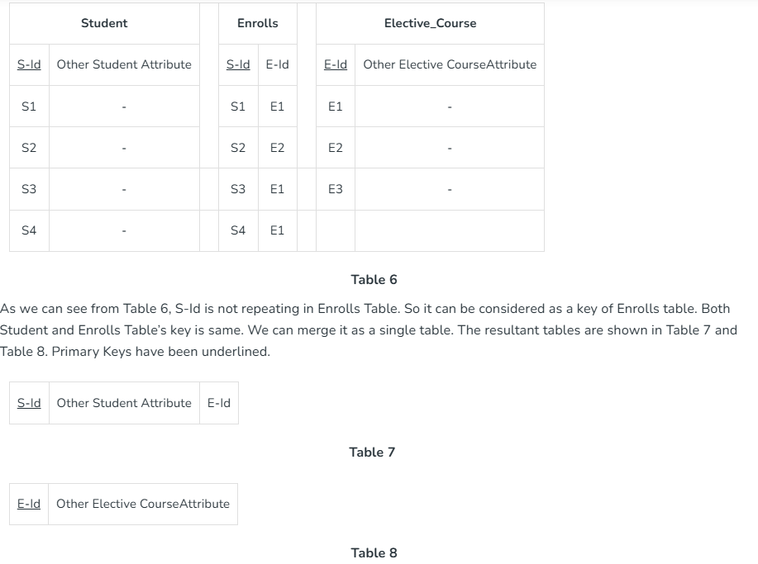

Slide 55
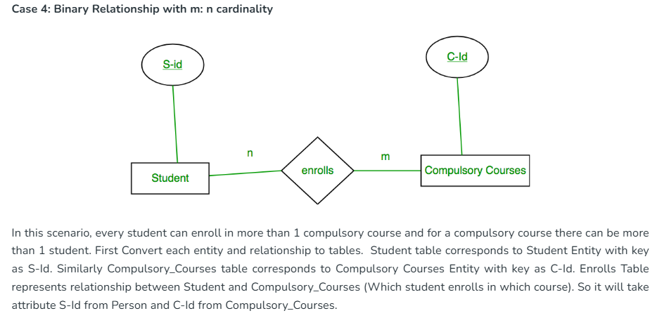

Slide 56
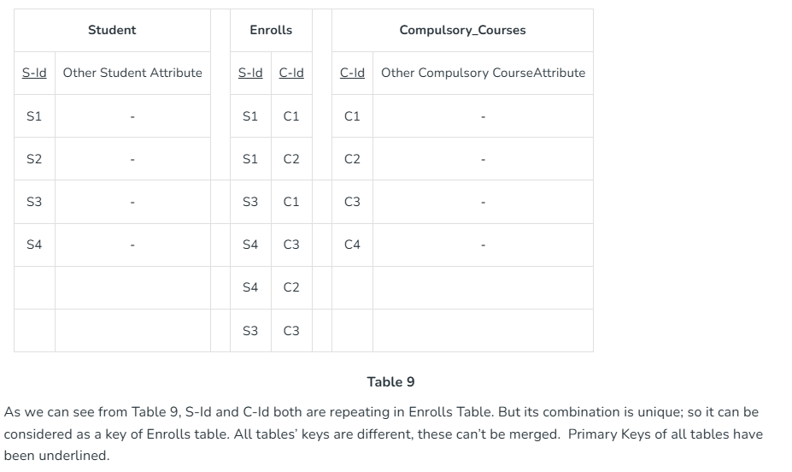

Slide 57
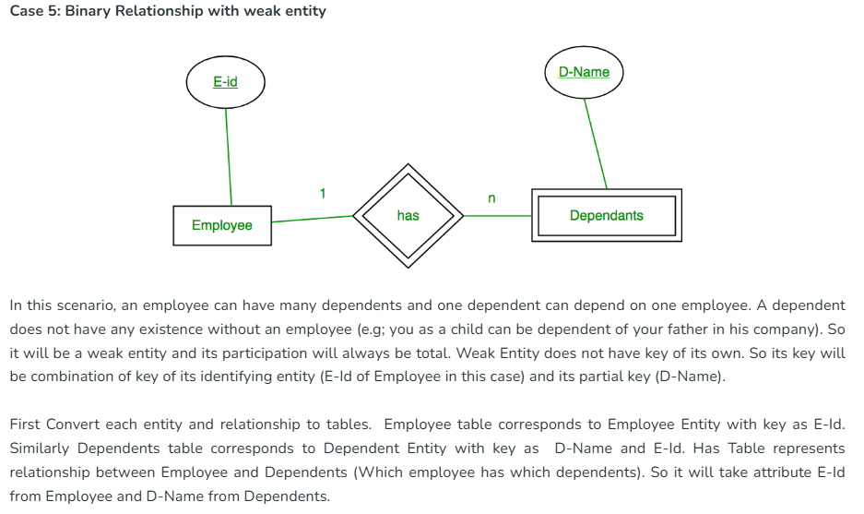

Slide 58
